Slide 1
Go My Code
Check-point git and github project
By
Nader Rabhi

Slide 2
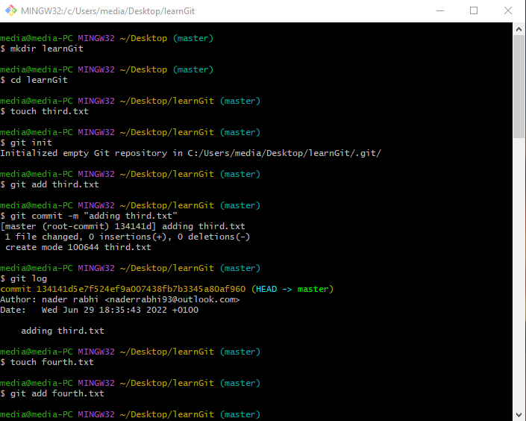
Create a folder called learnGit
$ mkdir learnGit
Cd (change directory) into the learn_git folder.
$ cd learnGit
Create a file called third.txt.
$ touch third.txt
Initialize an empty git repository.
$ git init
Add third.txt to the staging area.
$ git add third.txt
Commit with the message "adding third.txt".
$ git commit -m "adding third.txt“
Check out your commit with git log.
$ git log
Create another file called fourth.txt.
$ touch fourth.txt
Add fourth.txt to the staging area.
$ git add fourth.txt

Slide 3
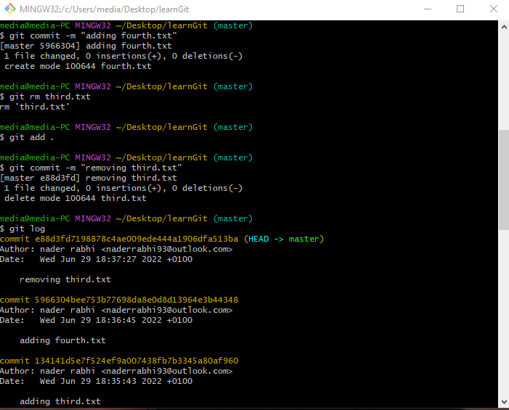
Commit with the message "adding fourth.txt«
$ git commit -m "adding fourth.txt“
Remove the third.txt file.
$ git rm third.txt
Add this change to the staging area. (Using the command "git add . «
$ git add .
Commit with the message "removing third.txt".
$ git commit -m "removing third.txt“
Check out your commits using git log.
$ git log

Slide 4
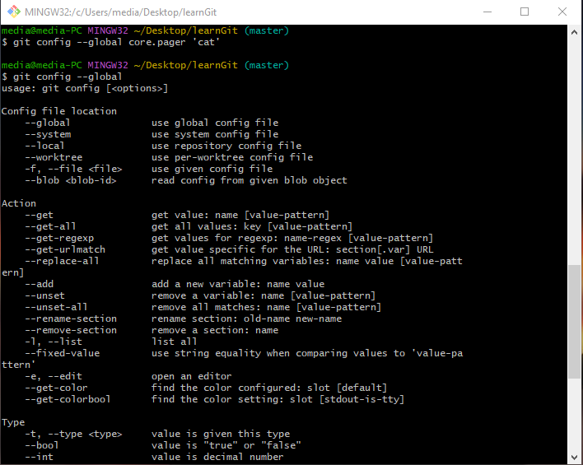
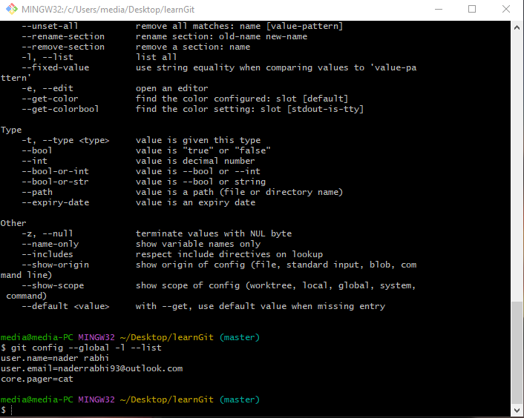
Change your global settings to core.pager = cat
$ git config --global core.pager 'cat‘
Write the appropriate command to list all the global configurations for git on your machine.
$ git config --global -l --list
You can type git config --global to find out how to do this.
$ git config --global

Slide 5
Thank yOu

